Slide 1
Web Page “Design”
Web Authoring and Design

Slide 2
Overview
Designing your website
What should and shouldn’t be on a webpage
How to ‘Design’ a successful website
Elements of a Web Page
Examples
Question/Discussion

Slide 3

Why does Design Matter?

Slide 4
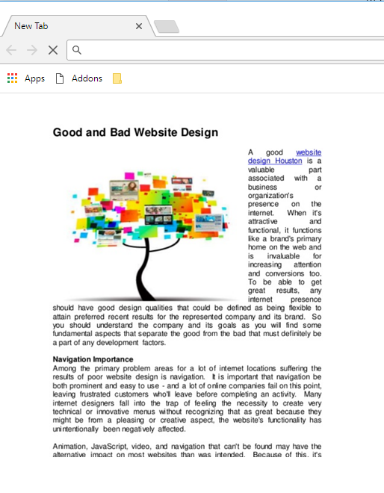

Look at these Web pages
What is wrong with these web pages?

Slide 5
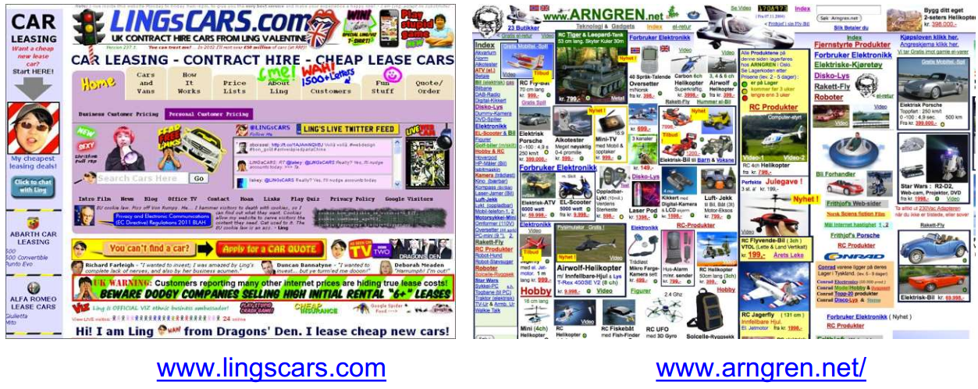
How do you feel about this website?

Slide 6
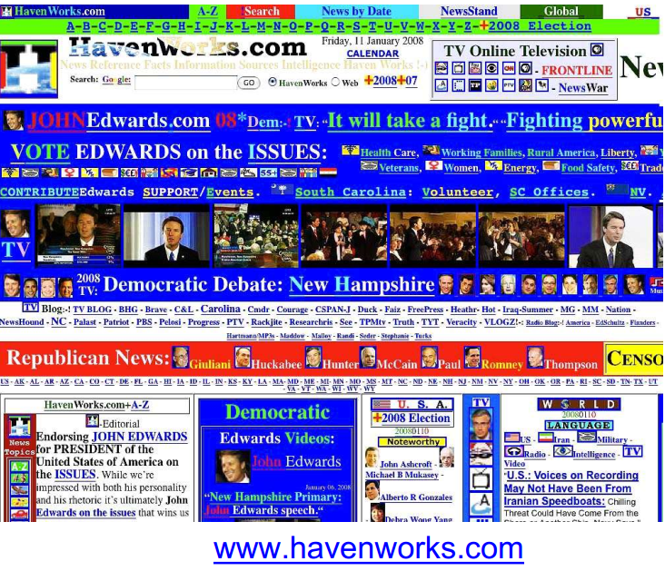
Bad Design
Can you tell the objective of this website?
Can you find any health care link?

Slide 7
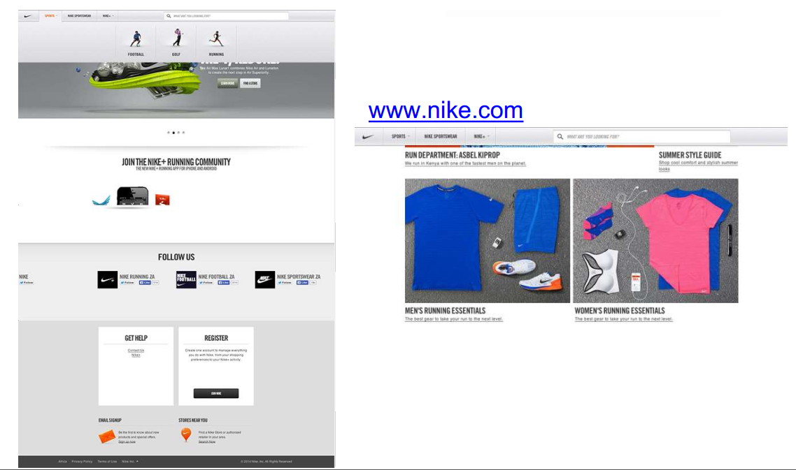
Good Design
How do you feel about this website?

Slide 8
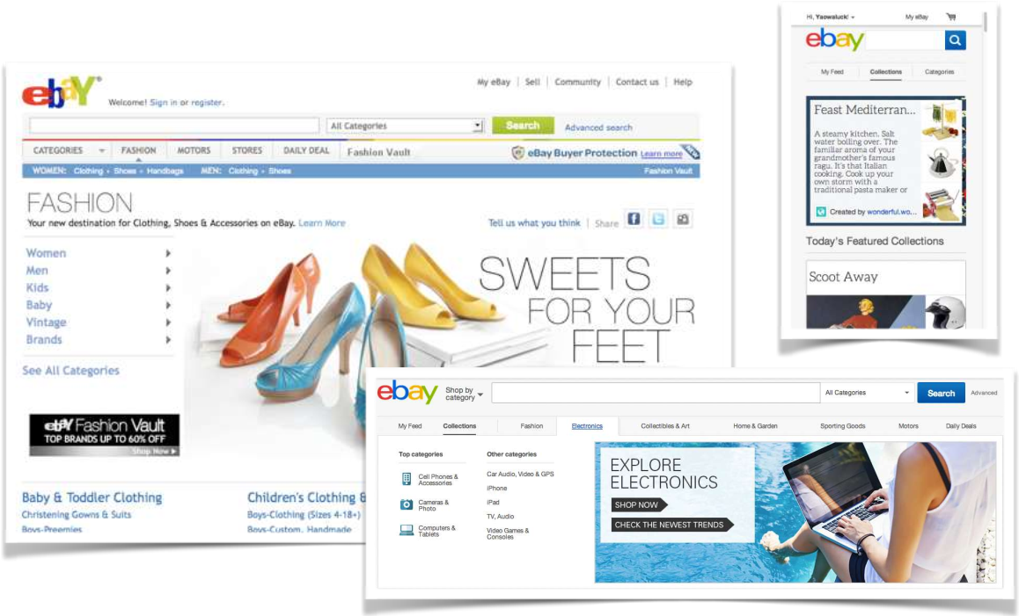
Good Design
Example e-commerce website

Slide 9
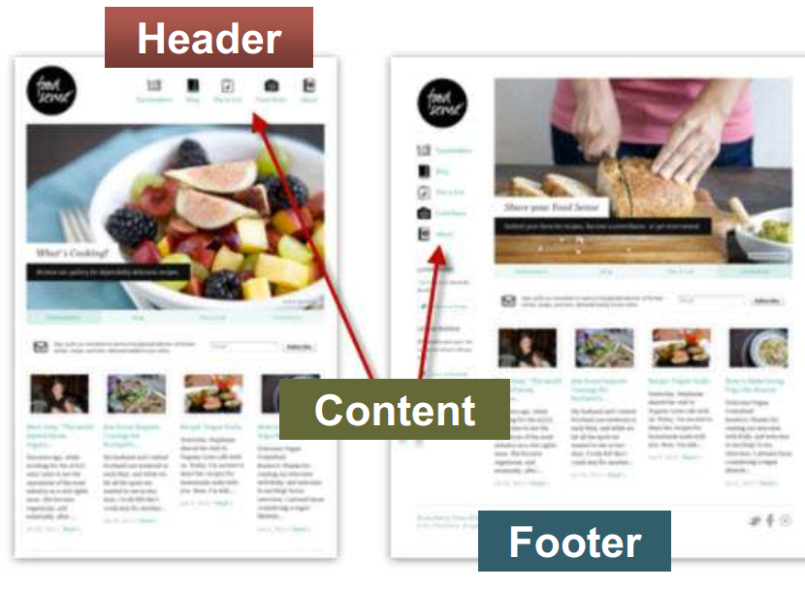
Elements of Web Design
Simplicity
Consistency
Uniqueness
Usefulness
Easy to use Navigation
Rapid Output
Clearance
Standardization
Responsive Web
Less errors

Slide 10
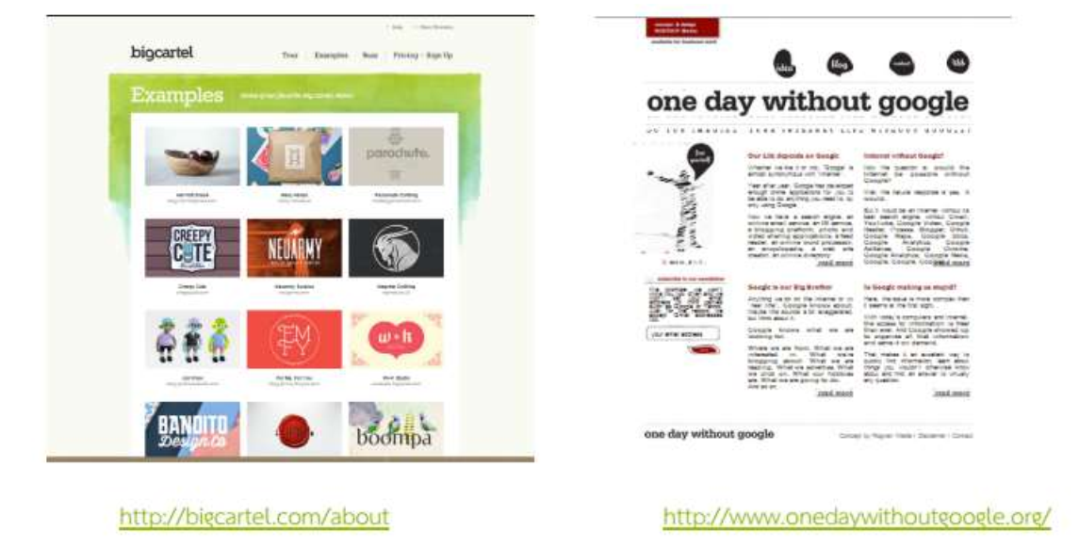
Simplicity

Slide 11
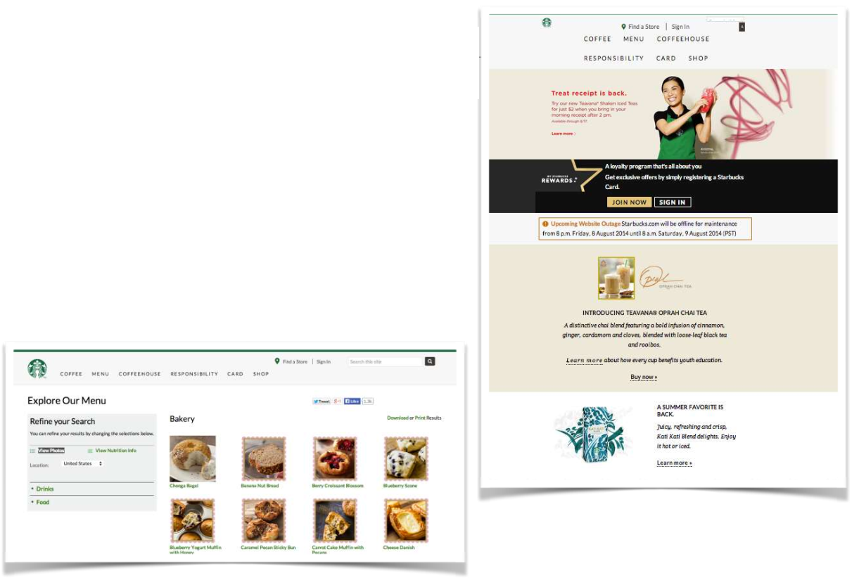
Consistency
Typographic consistency
Graphic consistency
Color consistency
Icon and button consistency

Slide 12
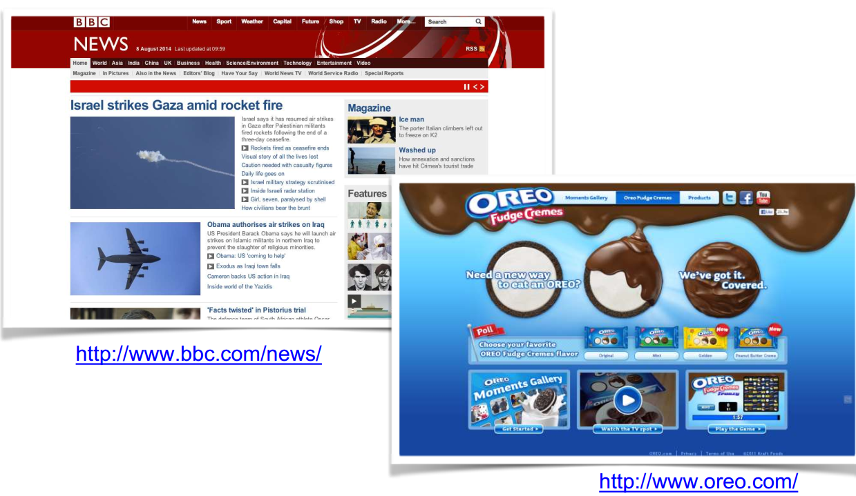
Uniqueness

Slide 13
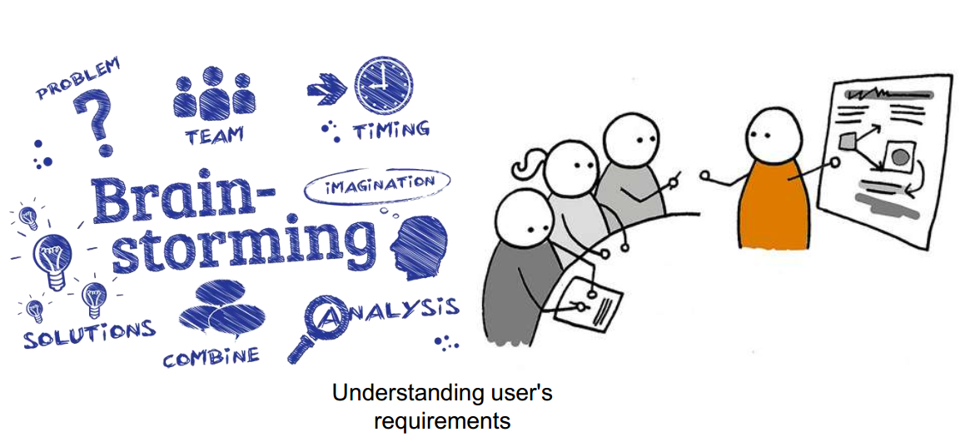
Usefulness
Usability is focused on designing the website to be easy to use

Slide 14
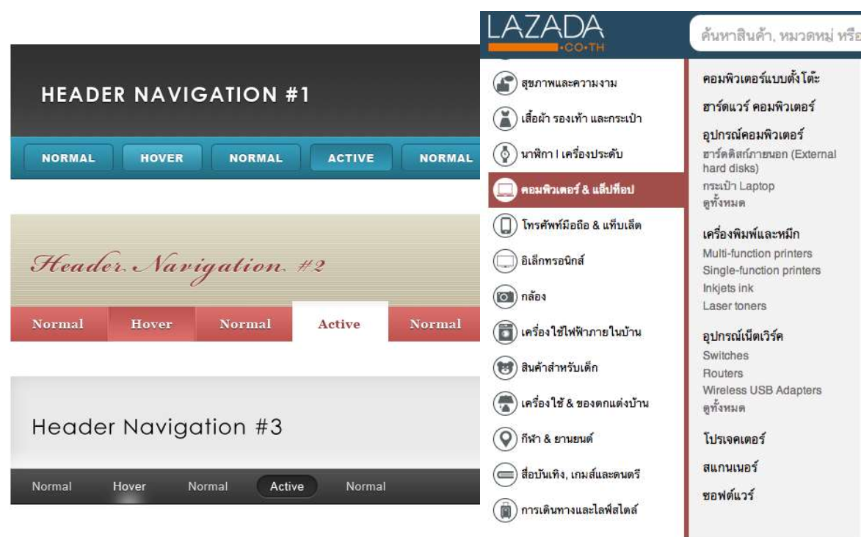
Easy to use Navigation

Slide 15

Responsive Web
Understanding Responsive Web Design: Cross browser Compatibility

Slide 16

Designing Your Page
Step 1: Design for a Computer Medium
A computer screen is not a printed page
Readability changes depending on color, layout, and format
Different browsers, screens and displays can change how a page looks

Slide 17

How We Read Text
Following normal reading habits, the users eye moves from left to right

Slide 18

How We View Screens
Looking at a screen, the users eye scans in a more clockwise pattern

Slide 19

How Will Your Users Read/View?
If a page uses a lot of text, the user will read in a more traditional, left to right manner.
If a page has more graphical elements, the user is more likely to take in the whole page.

Slide 20
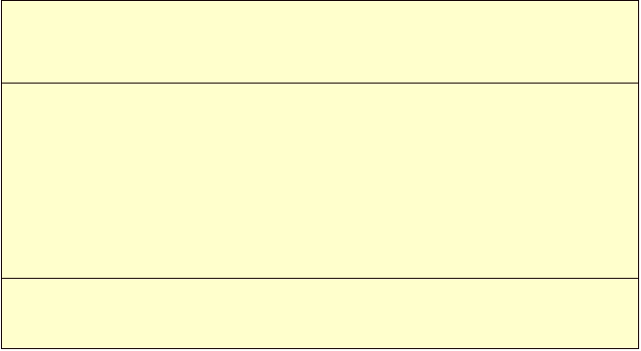




Accepted Relative Areas of Importance

Slide 21

Questions to Ask Yourself
What is the purpose of my website?
Who is my main audience?
My secondary audience?
What information do I want to present?

Slide 22

Designing Your Site
Step 2: Plan your sites hierarchy
How are your pages linked together?
How many links exactly?
Where does the user go next?

Slide 23

Designing Your Content
Step 3: The “do’s” of good web design
Name files consistently and logically
Keep a consistent look and feel
Use colors that are high in contrast
Design for low bandwidth

Slide 24
Designing Your Content
More do’s
Use active white space
Design for interaction
Use hypertext linking effectively
Design for accessibility

Slide 25

Designing Your Content
Step 4: Things to avoid, aka, the “don’ts”
Don’t overuse media
Don’t make users scroll too much
Don’t flood pages with content
Don’t choose colors or images that make the page hard to read

Slide 26
Designing Your Content
Don’t forget to title everything: images and pages
Don’t assume that your users know where to go
DON’T USE FRAMES!

Slide 27

Getting Started
Select a design tool/program
Determine page layout
Re-read assignment sheet and rubrics
Consider how best to represent “you”

Slide 28
Example

Slide 29
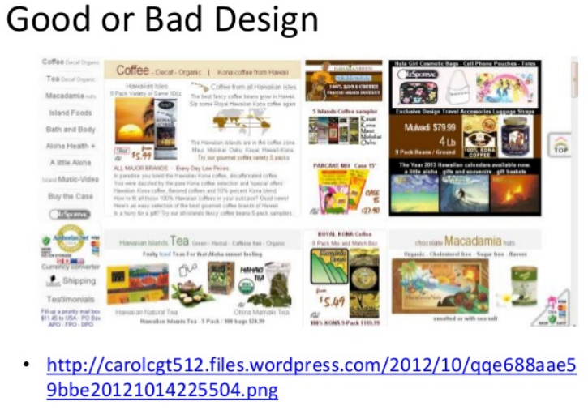

Slide 30

http://candccoffee.com

Slide 31
Tomorrow
(Thursday)
- 'Group' Project (demonstration of your javascript game – work in progress version)
- Explain/sketch your website `design'

Slide 32

Questions/Discussion
Do you know how to make a video?
Record the screen?
Add fade in/out effects
Add ‘text’ to your video
Title, student names, commentary, ...

